Slide 1
AMBULATORY PATIENT SAFETY: Building Bridges
April 11, 2016
CRICO- Barbara Szeidler, RN, BS, LNC, CPHQ
Cambridge Health Alliance- Lorraine Murphy, MS, RN
Atrius Health - Beverly Loudin, MD, MPH, FACOG
Brigham and Women’s Hospital –Karen Fiumara, PharmD, BCPS

Slide 2
CRICO/Risk Management Foundation of the Harvard Medical Institutes, Inc
Barbara Szeidler, RN, BS, LNC, CPHQ
bszeidler@rmf.Harvard.edu

Slide 3
Malpractice Claims are the
Tip of the Iceberg
Lack of updated family history
Inadequate communication
Lack of adequate assessment
Failure to reconcile test results
Narrow diagnostic focus
Failure to follow up with patient
Failure/delay ordering diagnostic test
Failure to follow protocol
Lack of accurate documentation
Failure to close the loop on referrals

Slide 4
Six Key Elements of an Ambulatory Patient Safety and Risk Management Program
Needs Assessment
Hazard Surveillance
Education
Assessing risk in the outpatient setting:
Ambulatory claims activity
Office Practice Evaluations
Ambulatory focus groups
Ambulatory Risk
Assessments
Self-assessment surveys
Identification of hazards in the outpatient setting:
Adverse events, near misses
Complaints
Ambulatory Walkrounds
Weekly Paper Rounds
Ambulatory M&Ms
Patient reporting/feedback
What, when, how, and why to report:
Training for MDs, office staff
  Risk Management basics
  Understanding of safety focused concepts
  Identification of hazards
  Reporting process
PI Initiatives
Communication & Spread
Culture of Safety
Problem areas in outpatient setting:
Electronic Medical Records
      Workflow Design
      Test Result & Referral Mgmt
      Clinical Decision Support
      Physician Informaticist
    Medication Safety
    Communication/Transparency
    Efficiency Projects
Feedback to outpatient physicians and staff:
Ambulatory Newsletters
Rewards Programs
Ambulatory data harm reports
Dashboards
Advisory Boards
Clinicians, staff and leadership committed to:
Safety and high quality care
Proactive improvement
Fair and just event review
Collaborative approach to problem solving
Focus on effective systems to drive improvements
Integration of initiatives into existing workflow

Slide 5
Cambridge Health Alliance
Lorraine Murphy, MS, RN
Ambulatory Risk and Patient Safety Manager
lemurphy@challaince.org

Slide 6
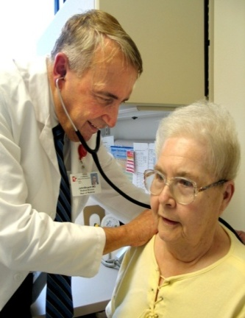




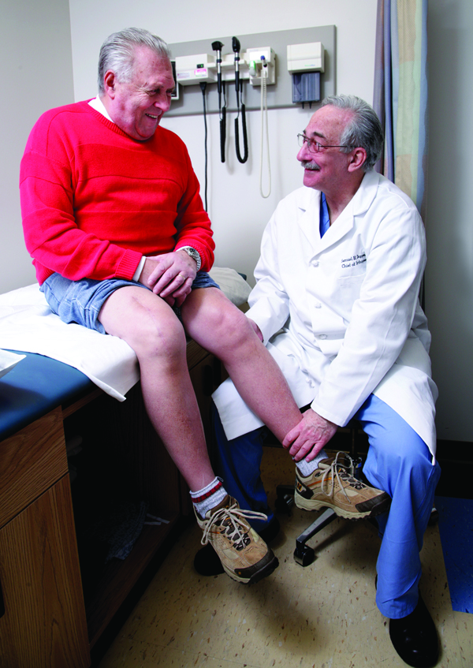
Cambridge Health Alliance
Safety-net healthcare system
Harvard Medical School teaching
hospital
Three hospital campuses
Community-based primary care with
integrated behavioral health
  Approximately 700,000 ambulatory
  care visits FY14
  At hospital campus clinics, 9 neighborhood health centers, 4 school-based health centers
  Integrated residency programs with Harvard and Tufts Medical Schools

Slide 7
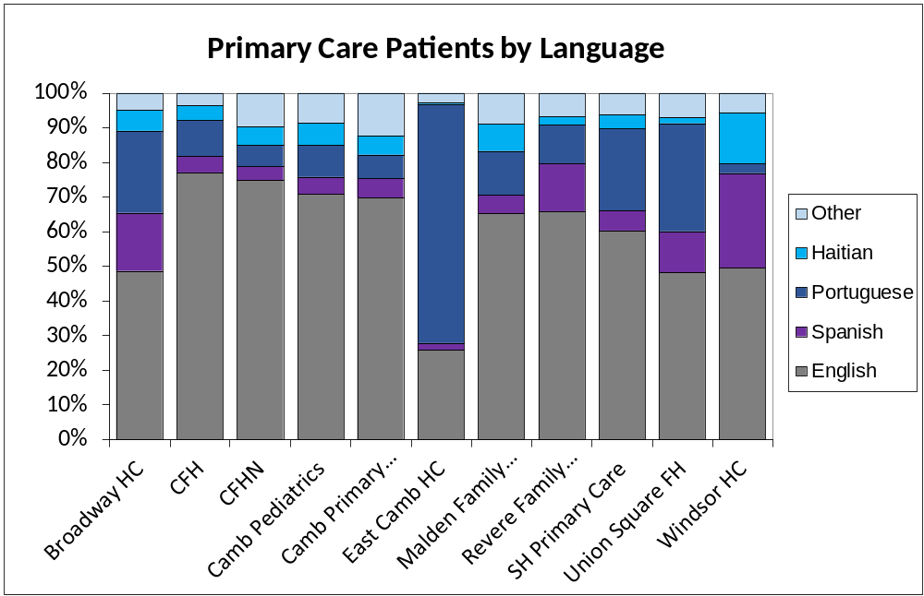
Almost HALF Our Patients Have a PRIMARY LANGUAGE OTHER THAN ENGLISH
Source: CHA Patient Demographics Reports on Staffnet. There may be some duplication across sites due to site integration. PM&MR June 2011.

Slide 8

Culture of Safety: Building
Building partnerships at all levels
  Medical Assistant Council and shadowing
  Resident education
  Ambulatory Joint Leadership meeting
  Partner with other “outsiders”
Constructing relationships through teams
  Key safety initiatives e.g., closing the loop on abnormals, referral management
  Staff meetings
  Referral Coordinators workgroup
Bridging gaps across sites, departments and levels of care
  Reports and RCAs evolving into PI initiatives
  Interdepartmental and interdisciplinary

Slide 9
Bridging the Gaps through Shared Investigation and Problem Solving
Root Cause Analyses examples
Focus: Flagging of specific abnormal results in EPIC | Physicians, lab techs, directors, IT worked collaboratively to change for inpt and outpt
Focus: Specimen pick-up/drop-off from off sites to lab | Outside vendor, lab, facilities, public safety, medical assistants, MD, RN, operations, telecommunications
Focus: Vaccine/medication refrigerators in ambulatory sites | Pharmacy, inpt/outpt, IT, facilities, biomed, nursing, materials mgt
HFMEA
Management of Provider in-basket when terminating from CHA | HR, Corporate Compliance, CQO, Physician Group, IT, Legal, Informatics
CHA-Wide Initiative
Disruptive Behavior Flag in Epic | Representatives from all departments and locations
Safety Review triggered by staff
Chemotherapy exposure | IT, Lab, ID, facilities, housekeeping, MD, RN

Slide 10
Culture of Safety: Assessing
Surveyed in 2012 and 2014
Key categories standout
  Overall Perceptions of Quality and Safety
  Leadership Support for Patient Safety
  Communication
  Teamwork
Survey coming Fall 2016
“If you talk to a man in a language he understands,
that goes to his head. If you talk to him in his language,
that goes to his heart.” – Nelson Mandela

Slide 11
Atrius Health
Beverly Loudin, MD, MPH, FACOG
Beverly_Loudin@AtriusHealth.org

Slide 12

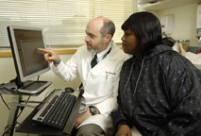
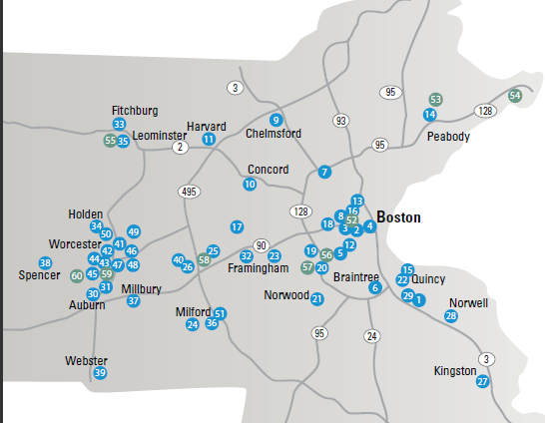
Atrius Health 2011-2014
Non-profit alliance of six leading independent medical groups in Eastern and Central Massachusetts and home health agency and hospice
Granite Medical Group
Dedham Medical Associates
Harvard Vanguard Medical Associates
Reliant Medical Group
Southboro Medical Group
South Shore Medical Center
VNA Care Network & Hospice, including VNA Boston
Providing care for ~ 1,000,000 adult and pediatric patients with 1100 physicians, 2100 other healthcare professionals across 35 specialties

Slide 13
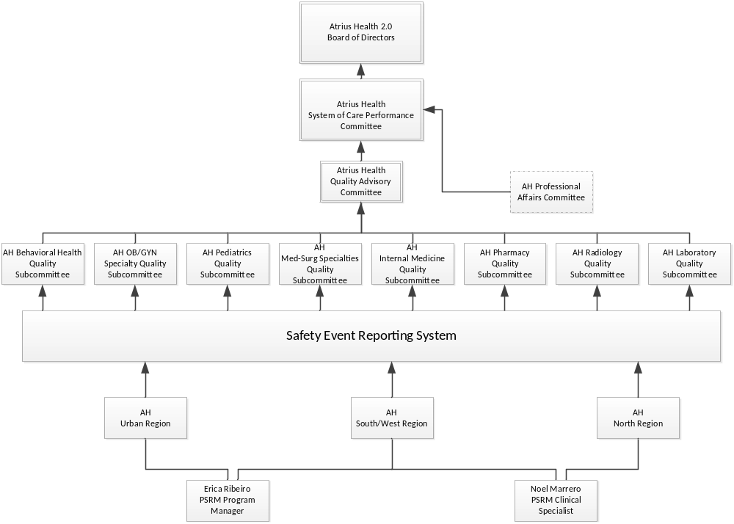
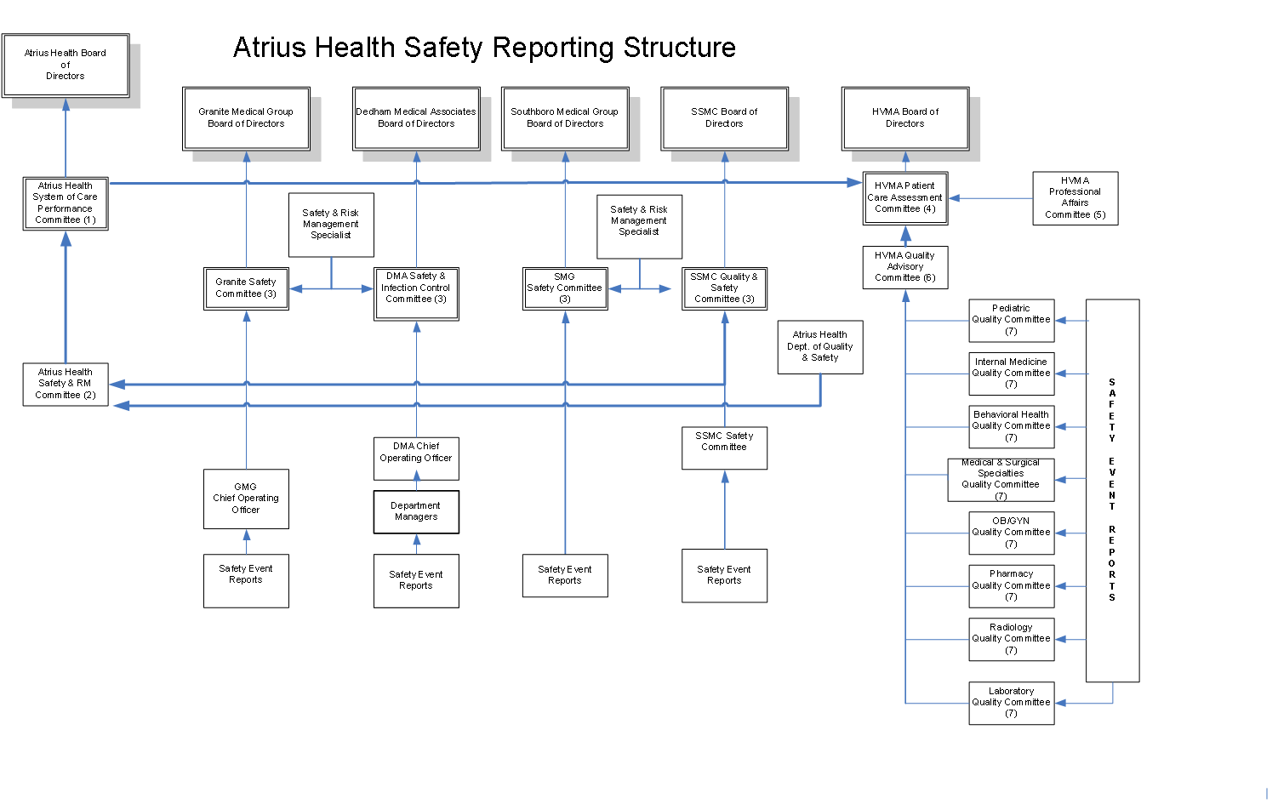

Slide 14
Atrius Health Ambulatory Risks

Slide 15
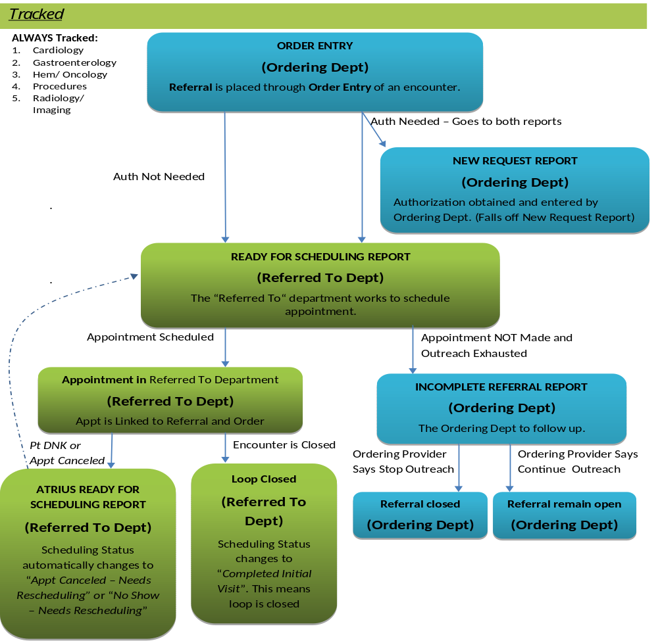
Atrius
Health
Ambulatory
Risks
Referral Management

Slide 16
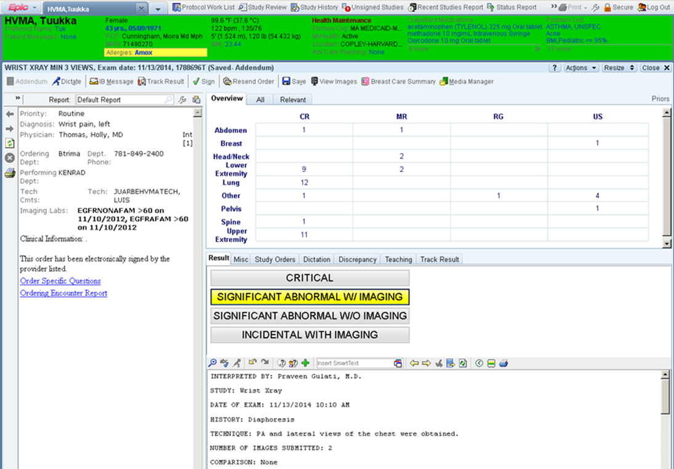
Atrius Health Ambulatory Risks
Abnormal Radiology Results Management: Radiologist

Slide 17
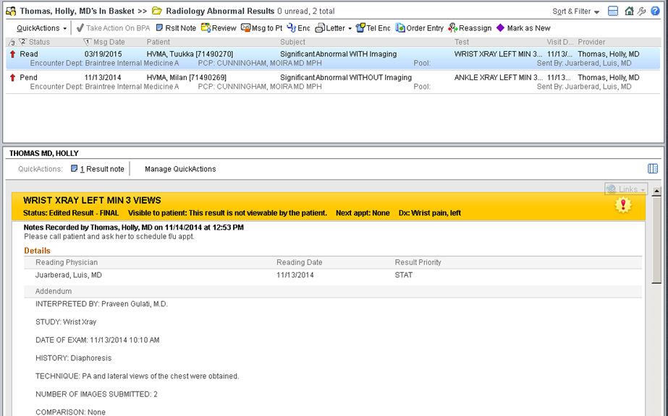
Atrius Health Ambulatory Risks
Abnormal Radiology Results Management: Provider

Slide 18
Brigham and Women’s Hospital
Karen Fiumara, Senior Director Patient Safety, BWH
Sonali Desai, Medical Director Ambulatory Patient Safety, BWH
kfiumara@partners.org
sdesai15@partners.org

Slide 19
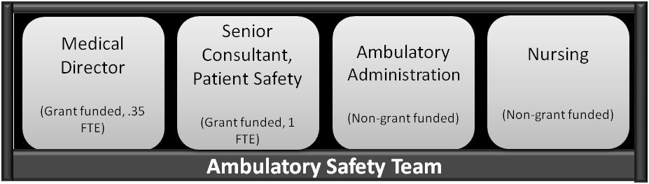
Brigham and Women’s Hospital
BWH Ambulatory Safety Team
Safety Reporting
Patient Safety Nets
Culture / Patient Safety
Medication Safety
145 ambulatory practices
22 physical sites
3+ million annual visits

Slide 20
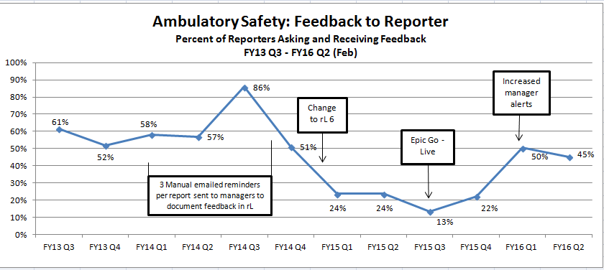
Safety Reporting: Providing Feedback
Goal: 80% by 8/1/16
Plan
Support: manager education and toolkit “how to”
Workflow: reminders to managers via email with link to electronic reporting system
Accountability: monthly data sharing with Executive Sponsors

Slide 21
Just Culture: Creating a Culture of Safety
Target Audience | Who | What | Status
Just Culture Advisors | BWH experts (HR, Peer Support, Risk, CCE, CNE, QARM, DQS, etc.) | 1-day training 6 one-hr meetings a year | 5 Advisor sessions 115 Advisors trained
Senior Execs | Senior Execs + Chairs (46 trained) | 90 min training | Completed 2/14
Managers | ~1,100 Managers (clinical and non- clinical) | 3 hr training | 40 Manager sessions 733 Managers trained
Staff | All Staff | 6 min video | Planned for 2016
73% of managers trained

Slide 22

Questions?
bszeidler@rmf.harvard.edu

